Slide 1
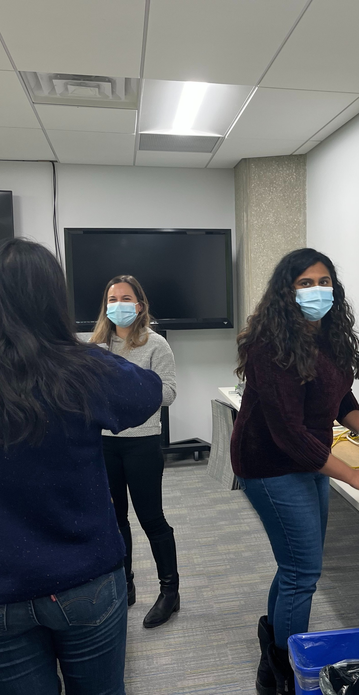
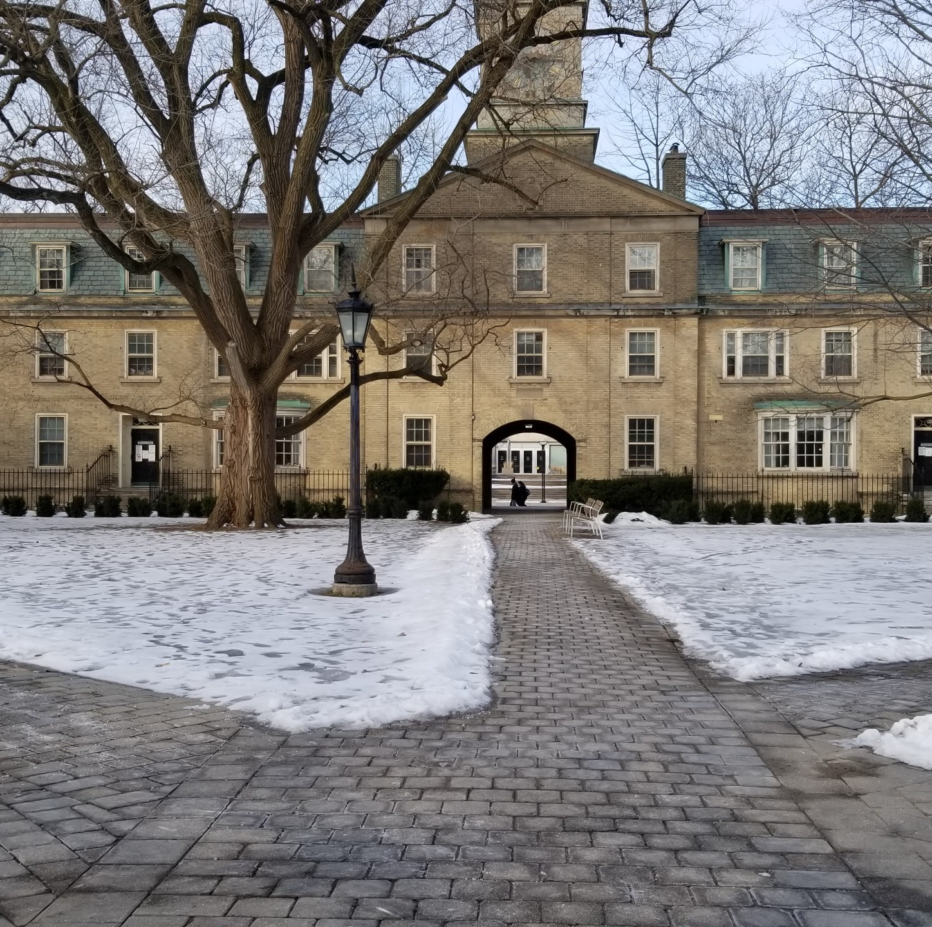
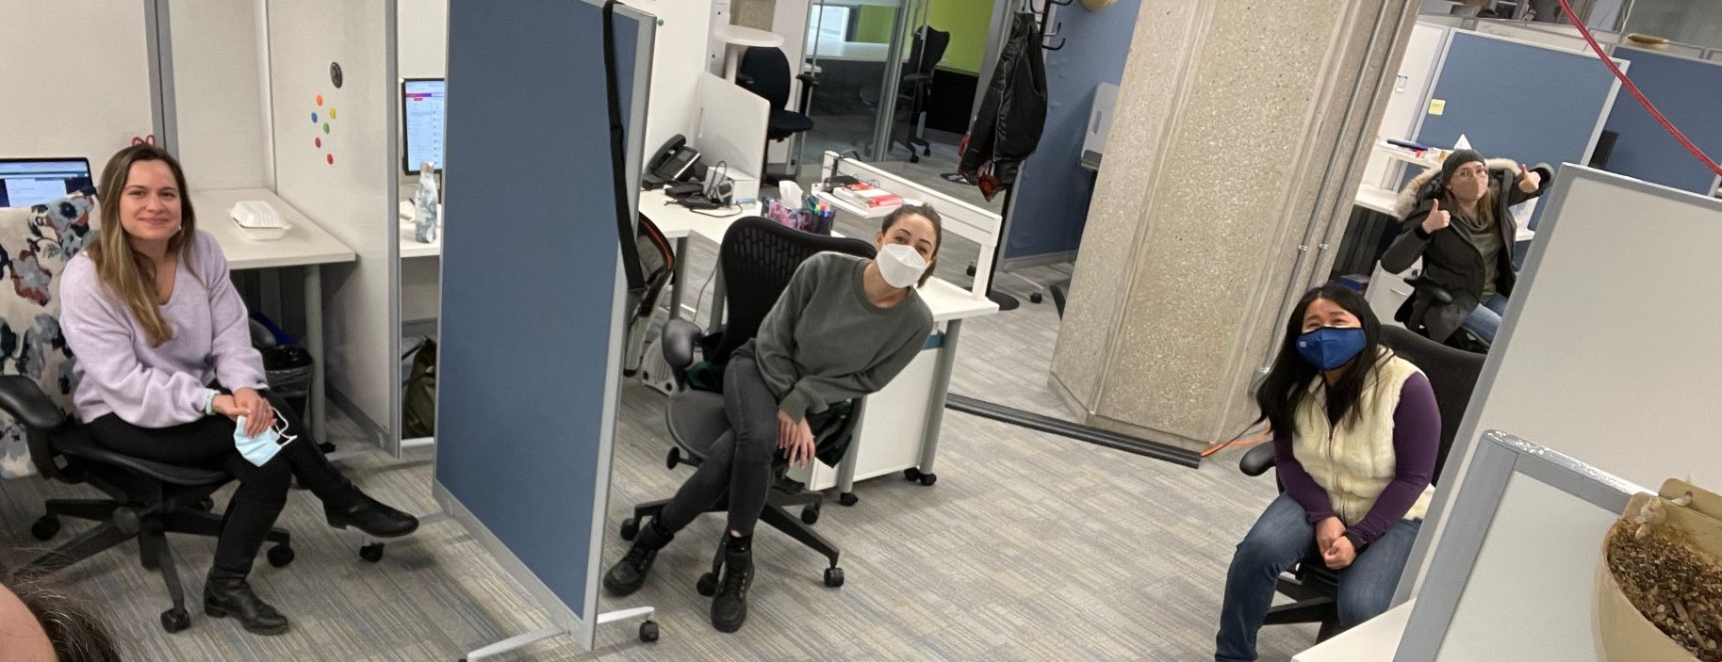
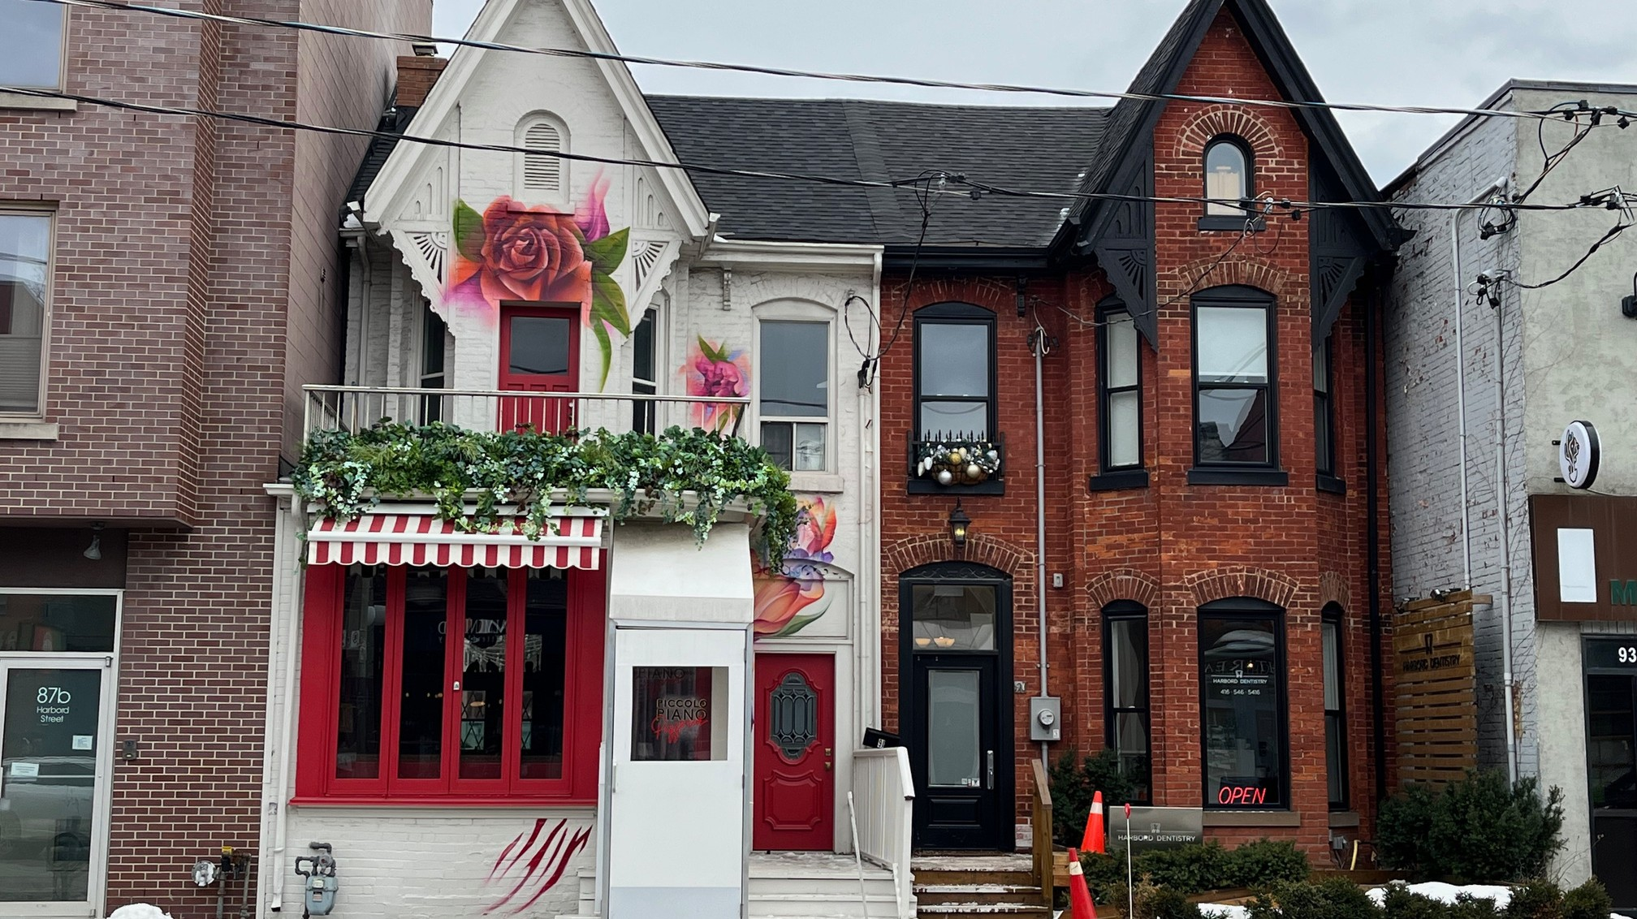
DAY IN THE LIFE: YOUR TEAM NAME HERE

Slide 2
Welcome to our office:
YOUR BUILDING NAME
Address (optional)

Slide 3
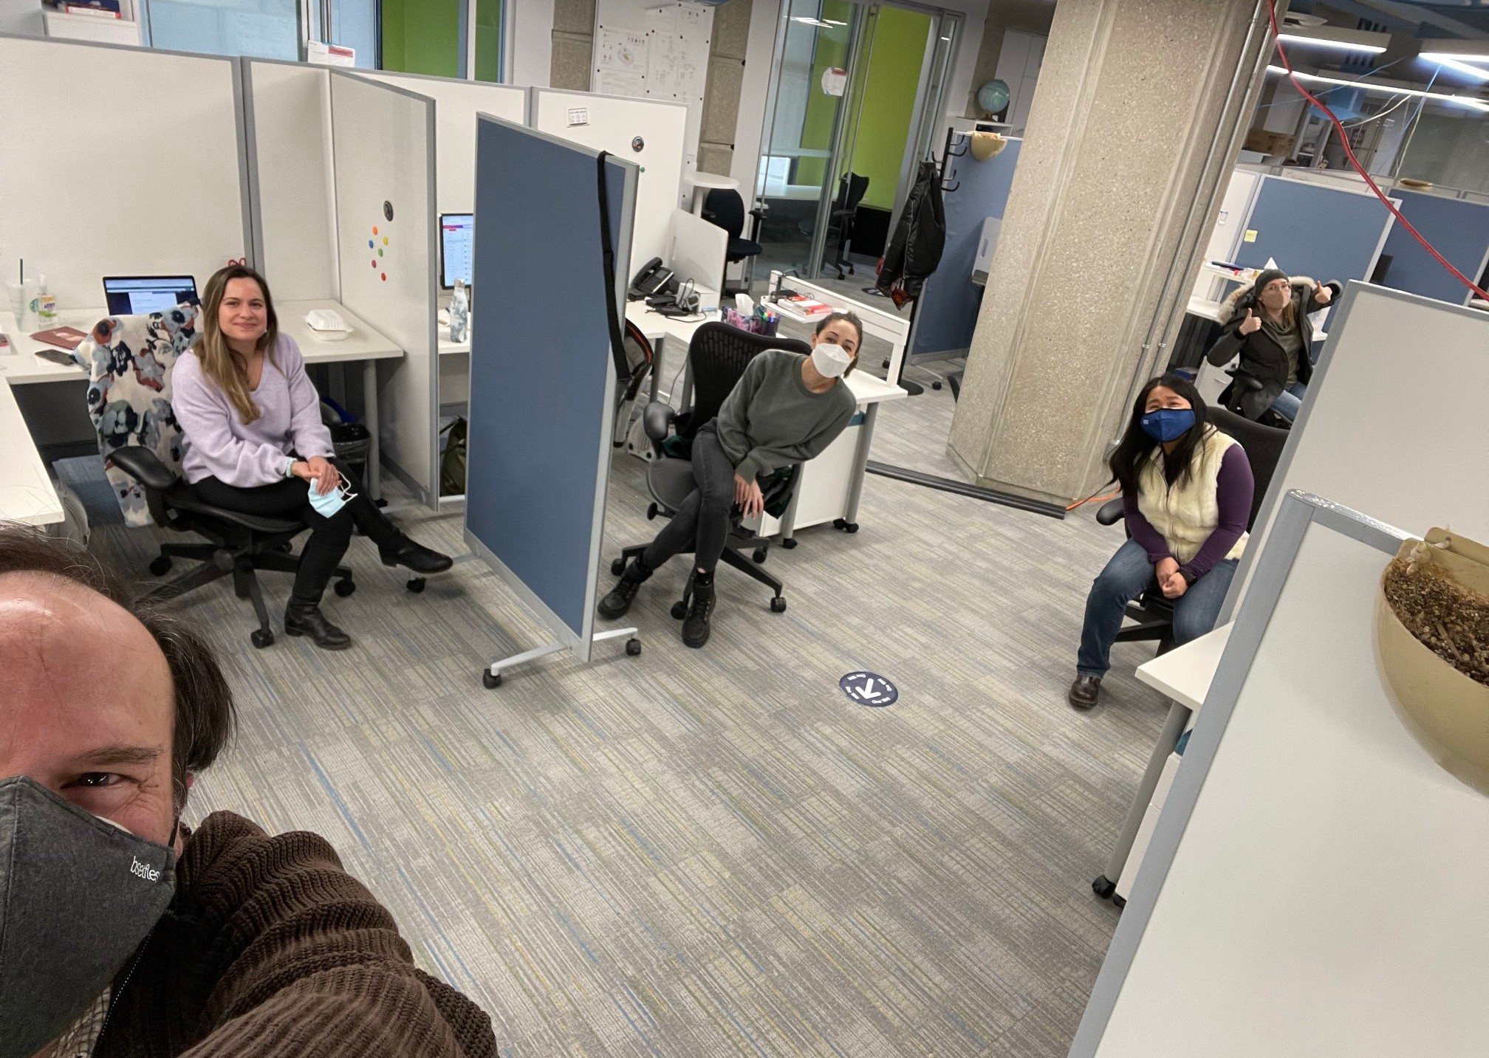
Meet (some of) the team!

Slide 4
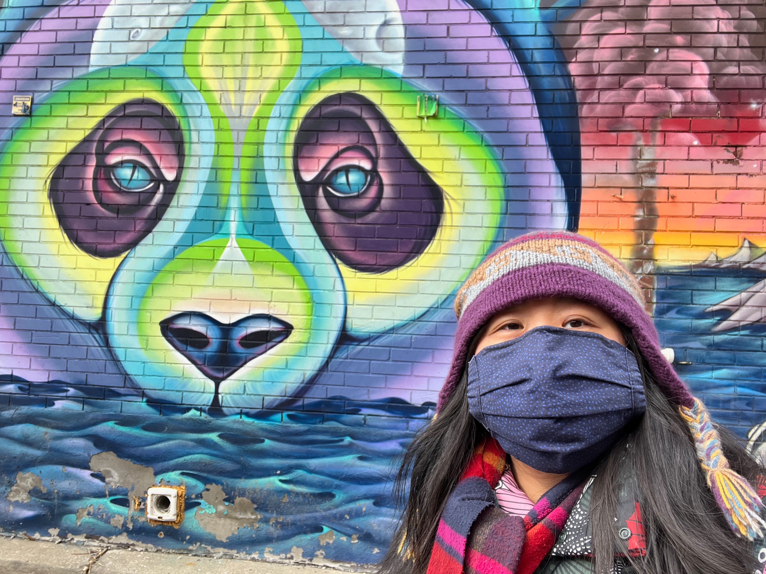
Our favourite campus walks

Slide 5
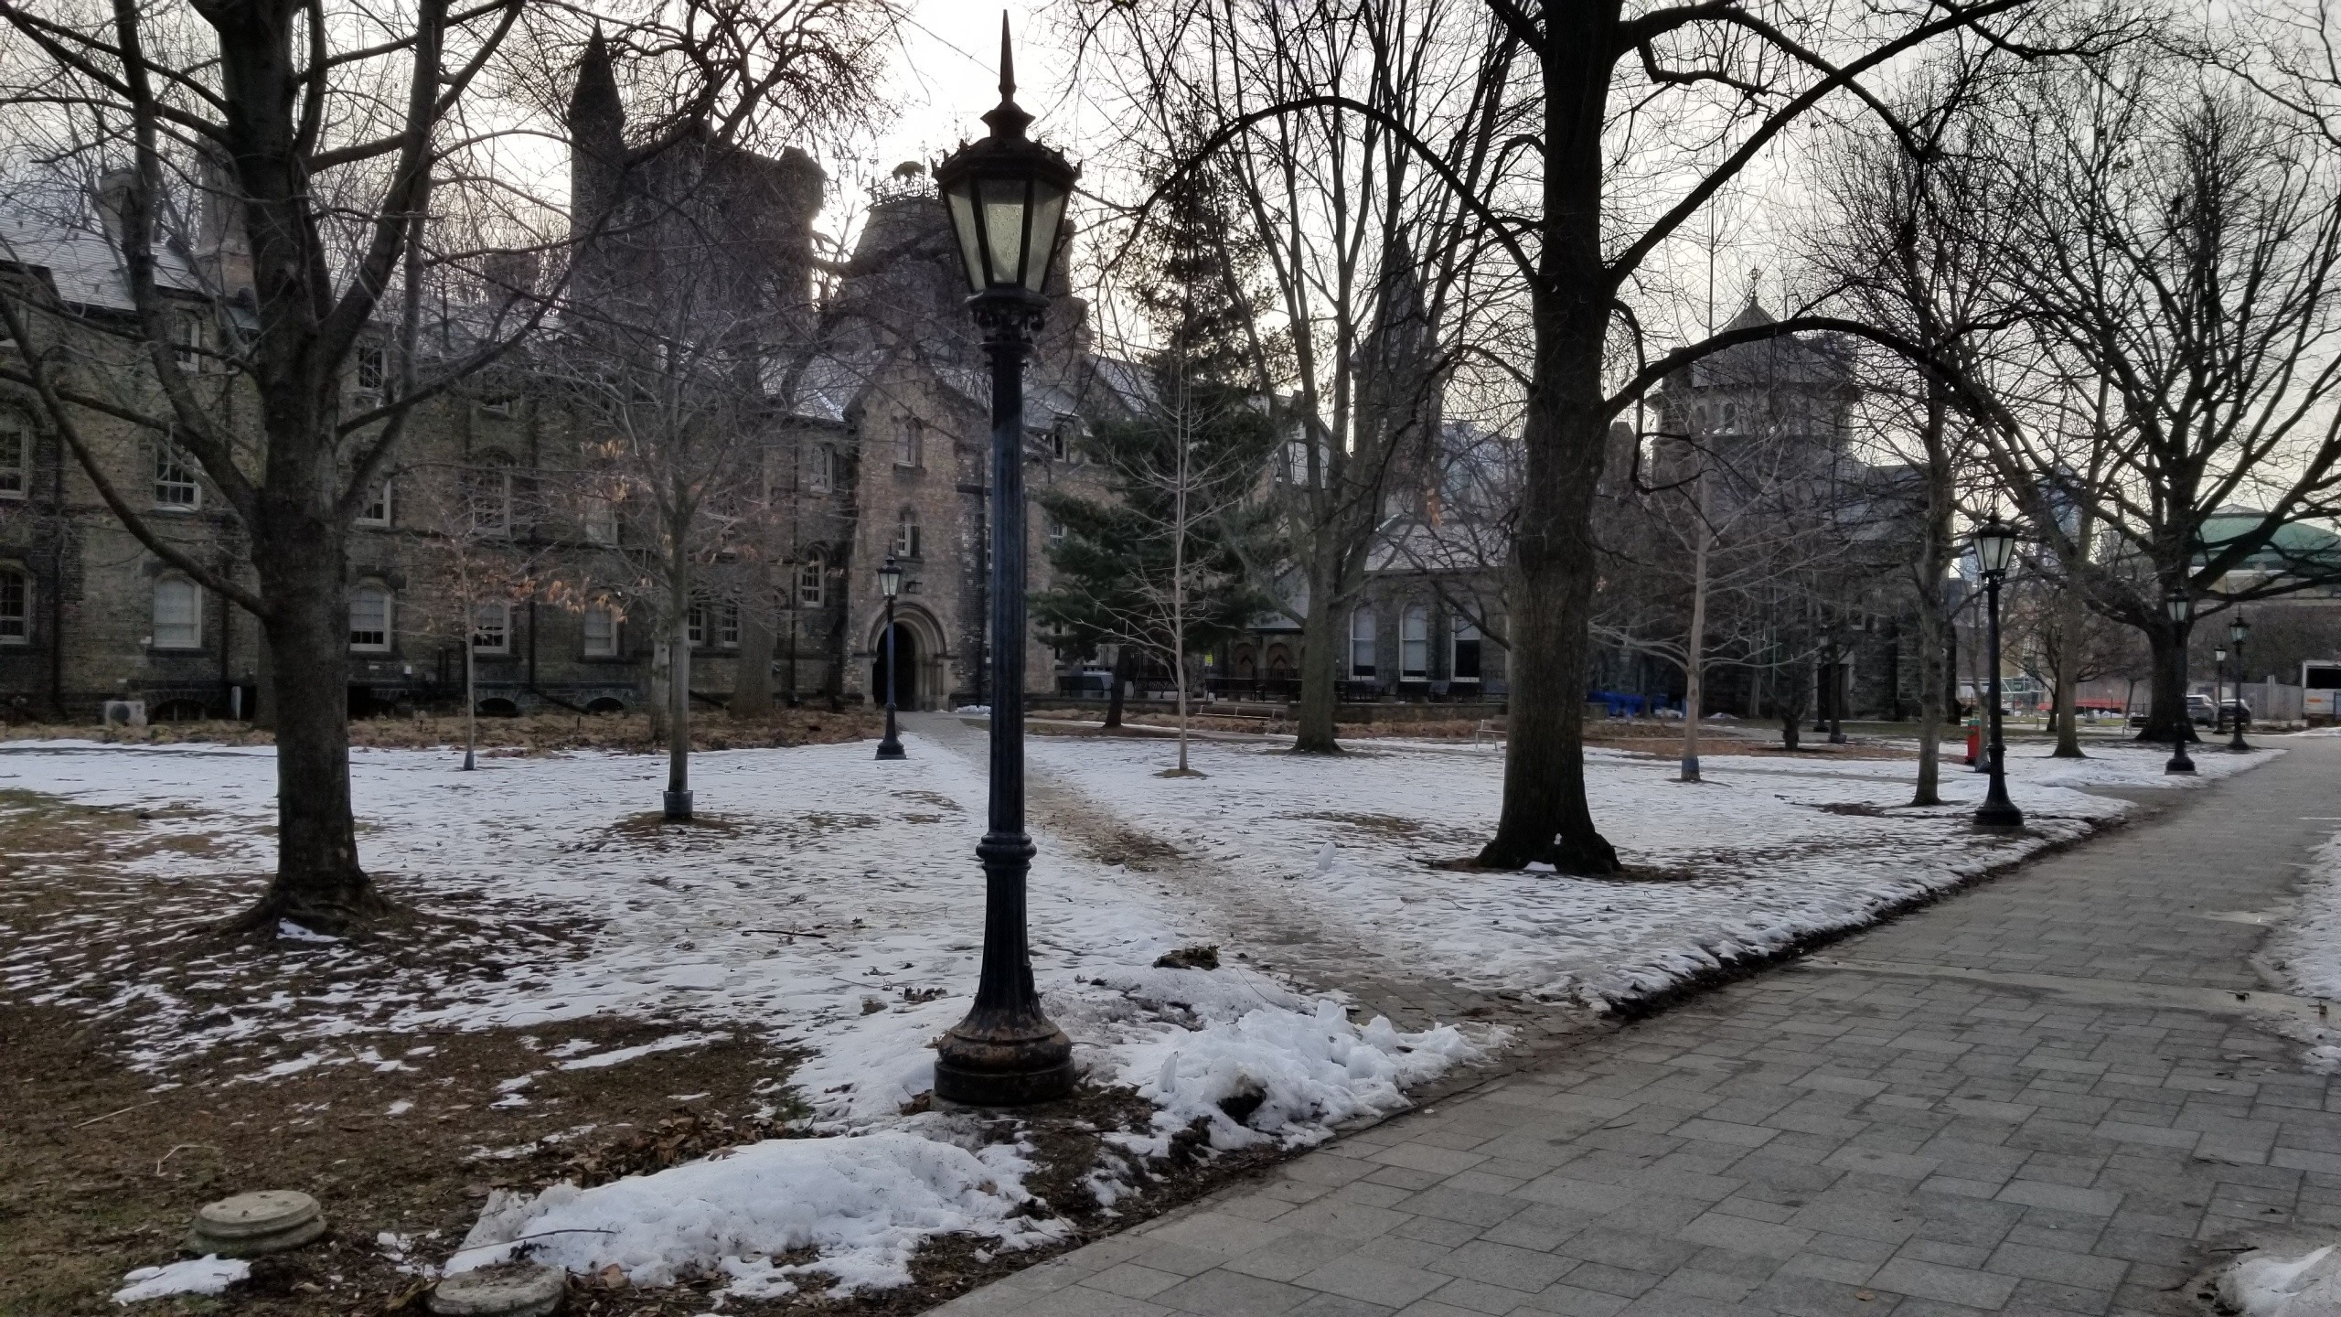
U of T Front Campus

Slide 6
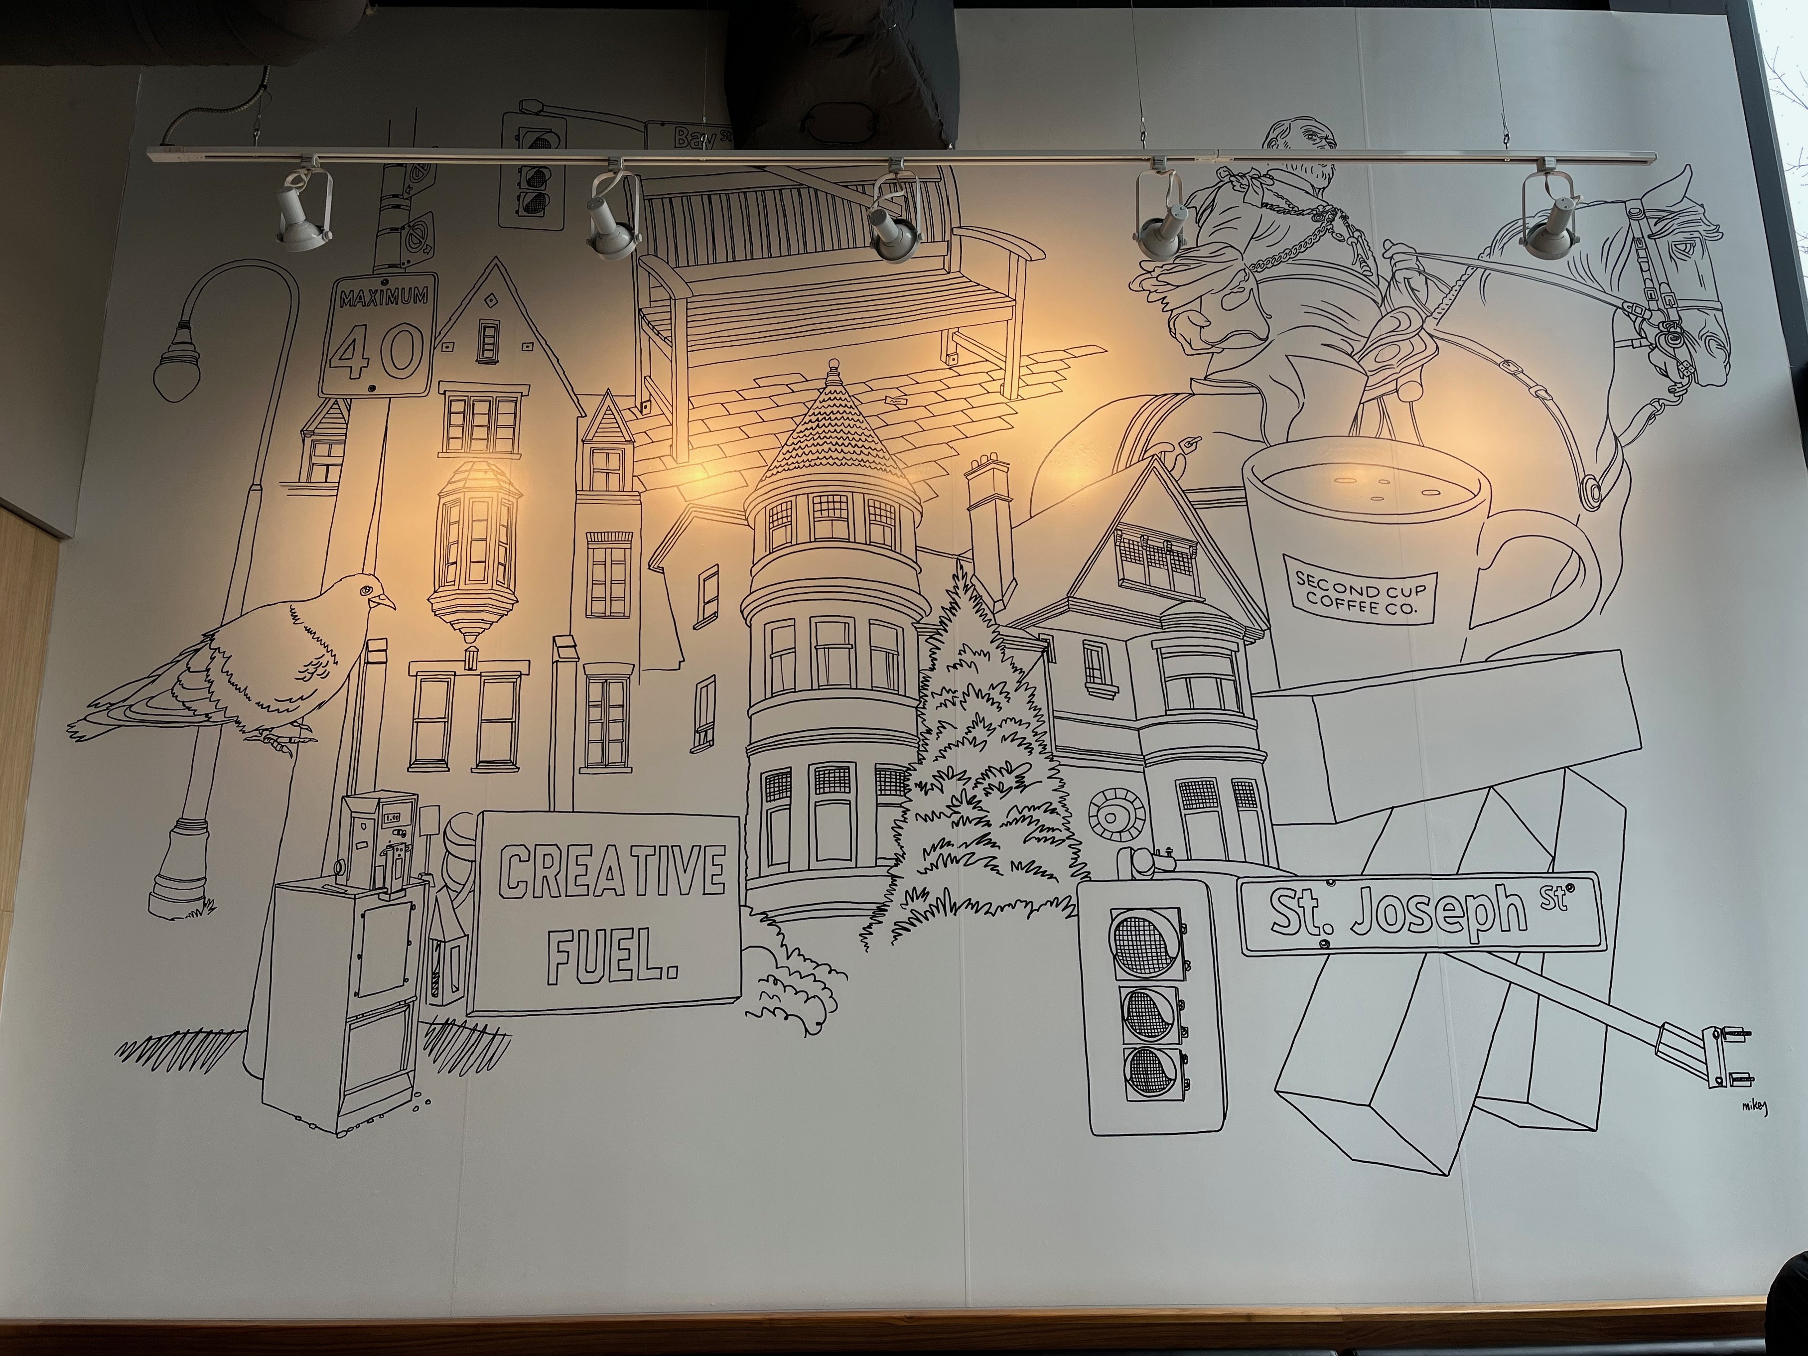
Our favourite coffee shops

Slide 7
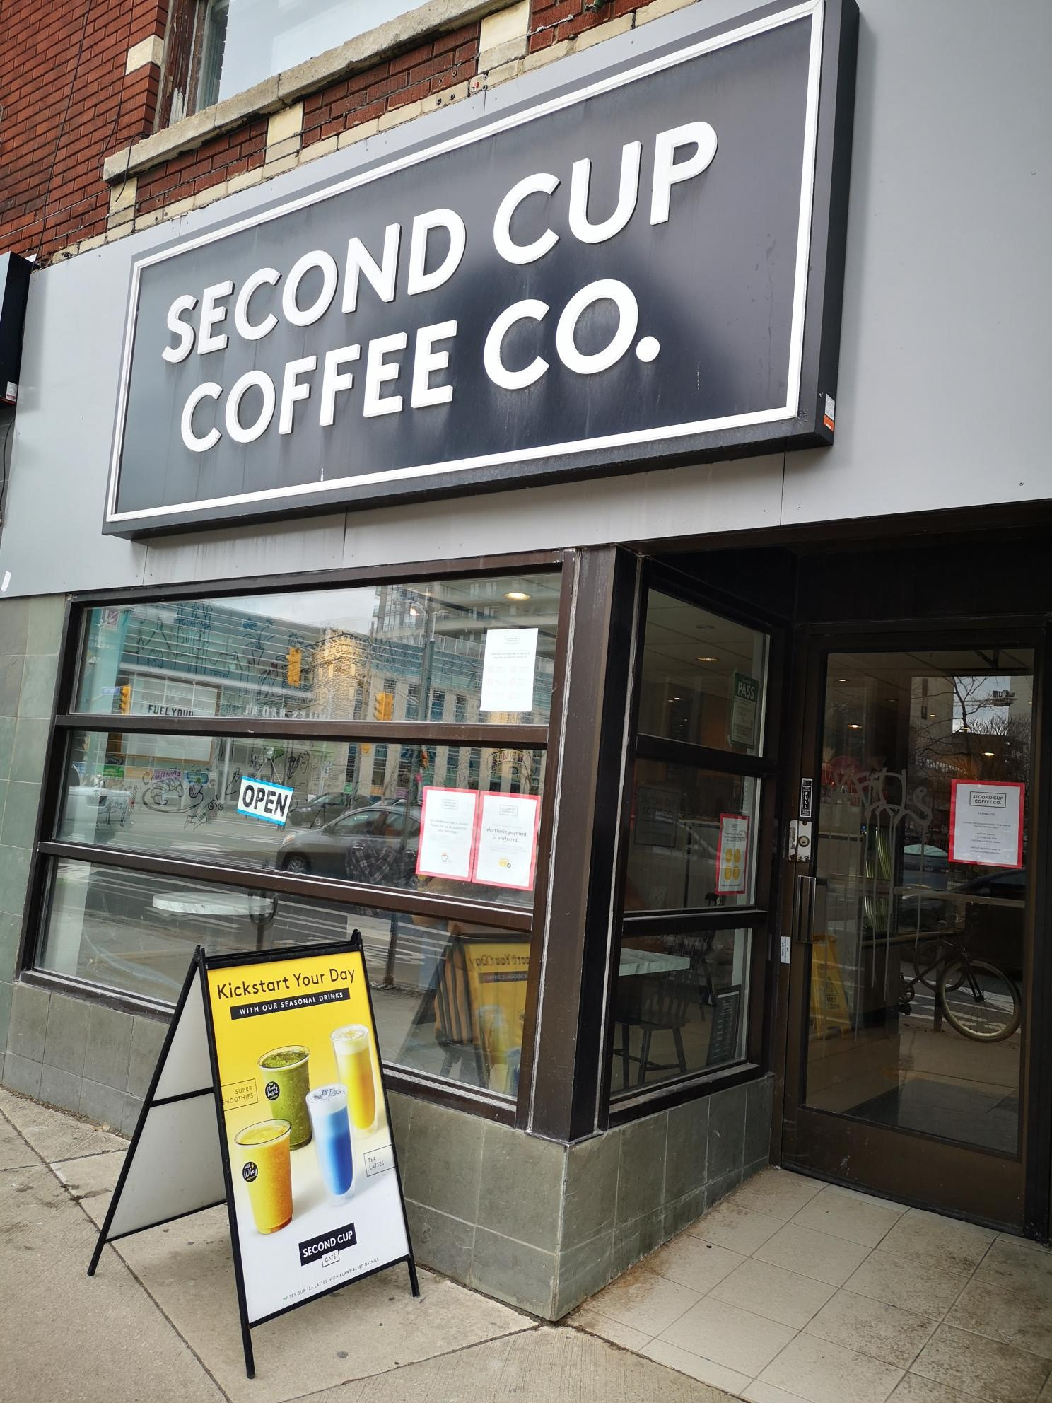
Second Cup
324 Bloor St. W.

Slide 8
Our favourite lunch spots

Slide 9
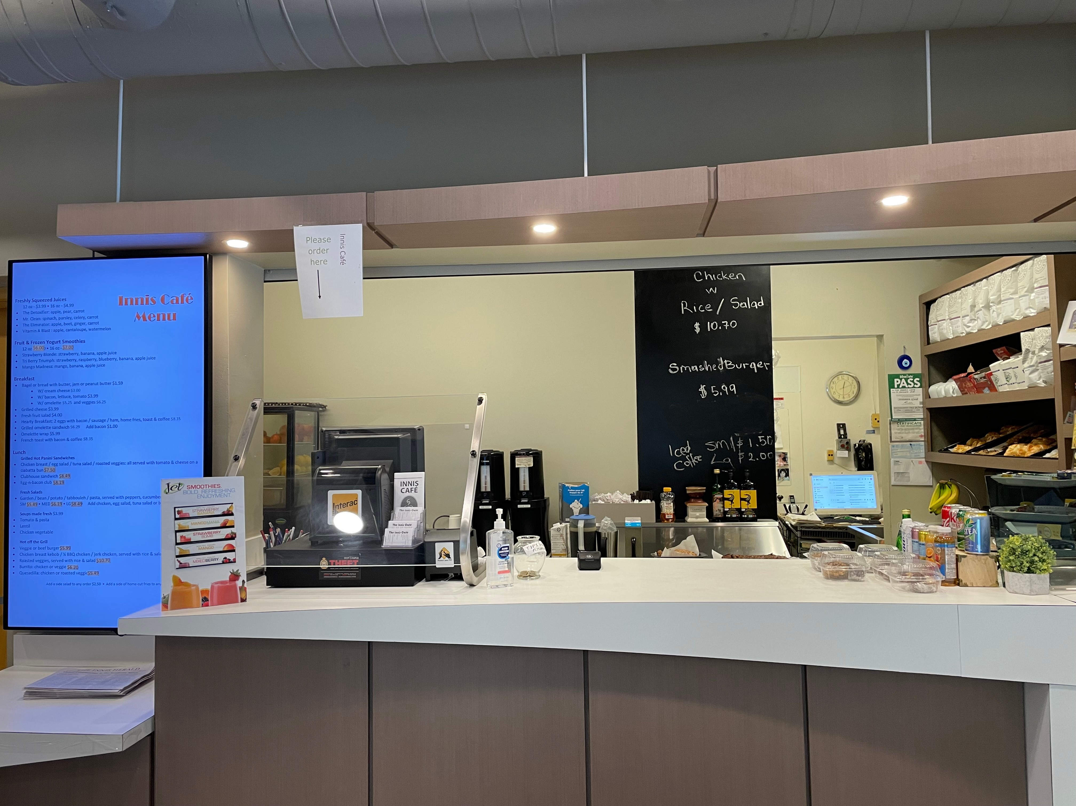
Innis café
Right next door!

Slide 10
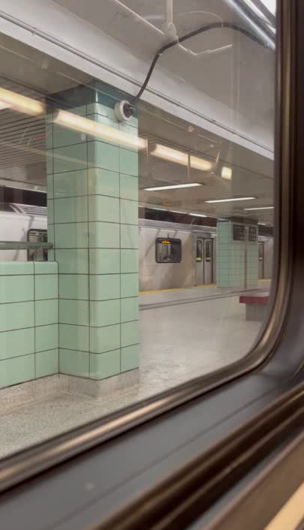
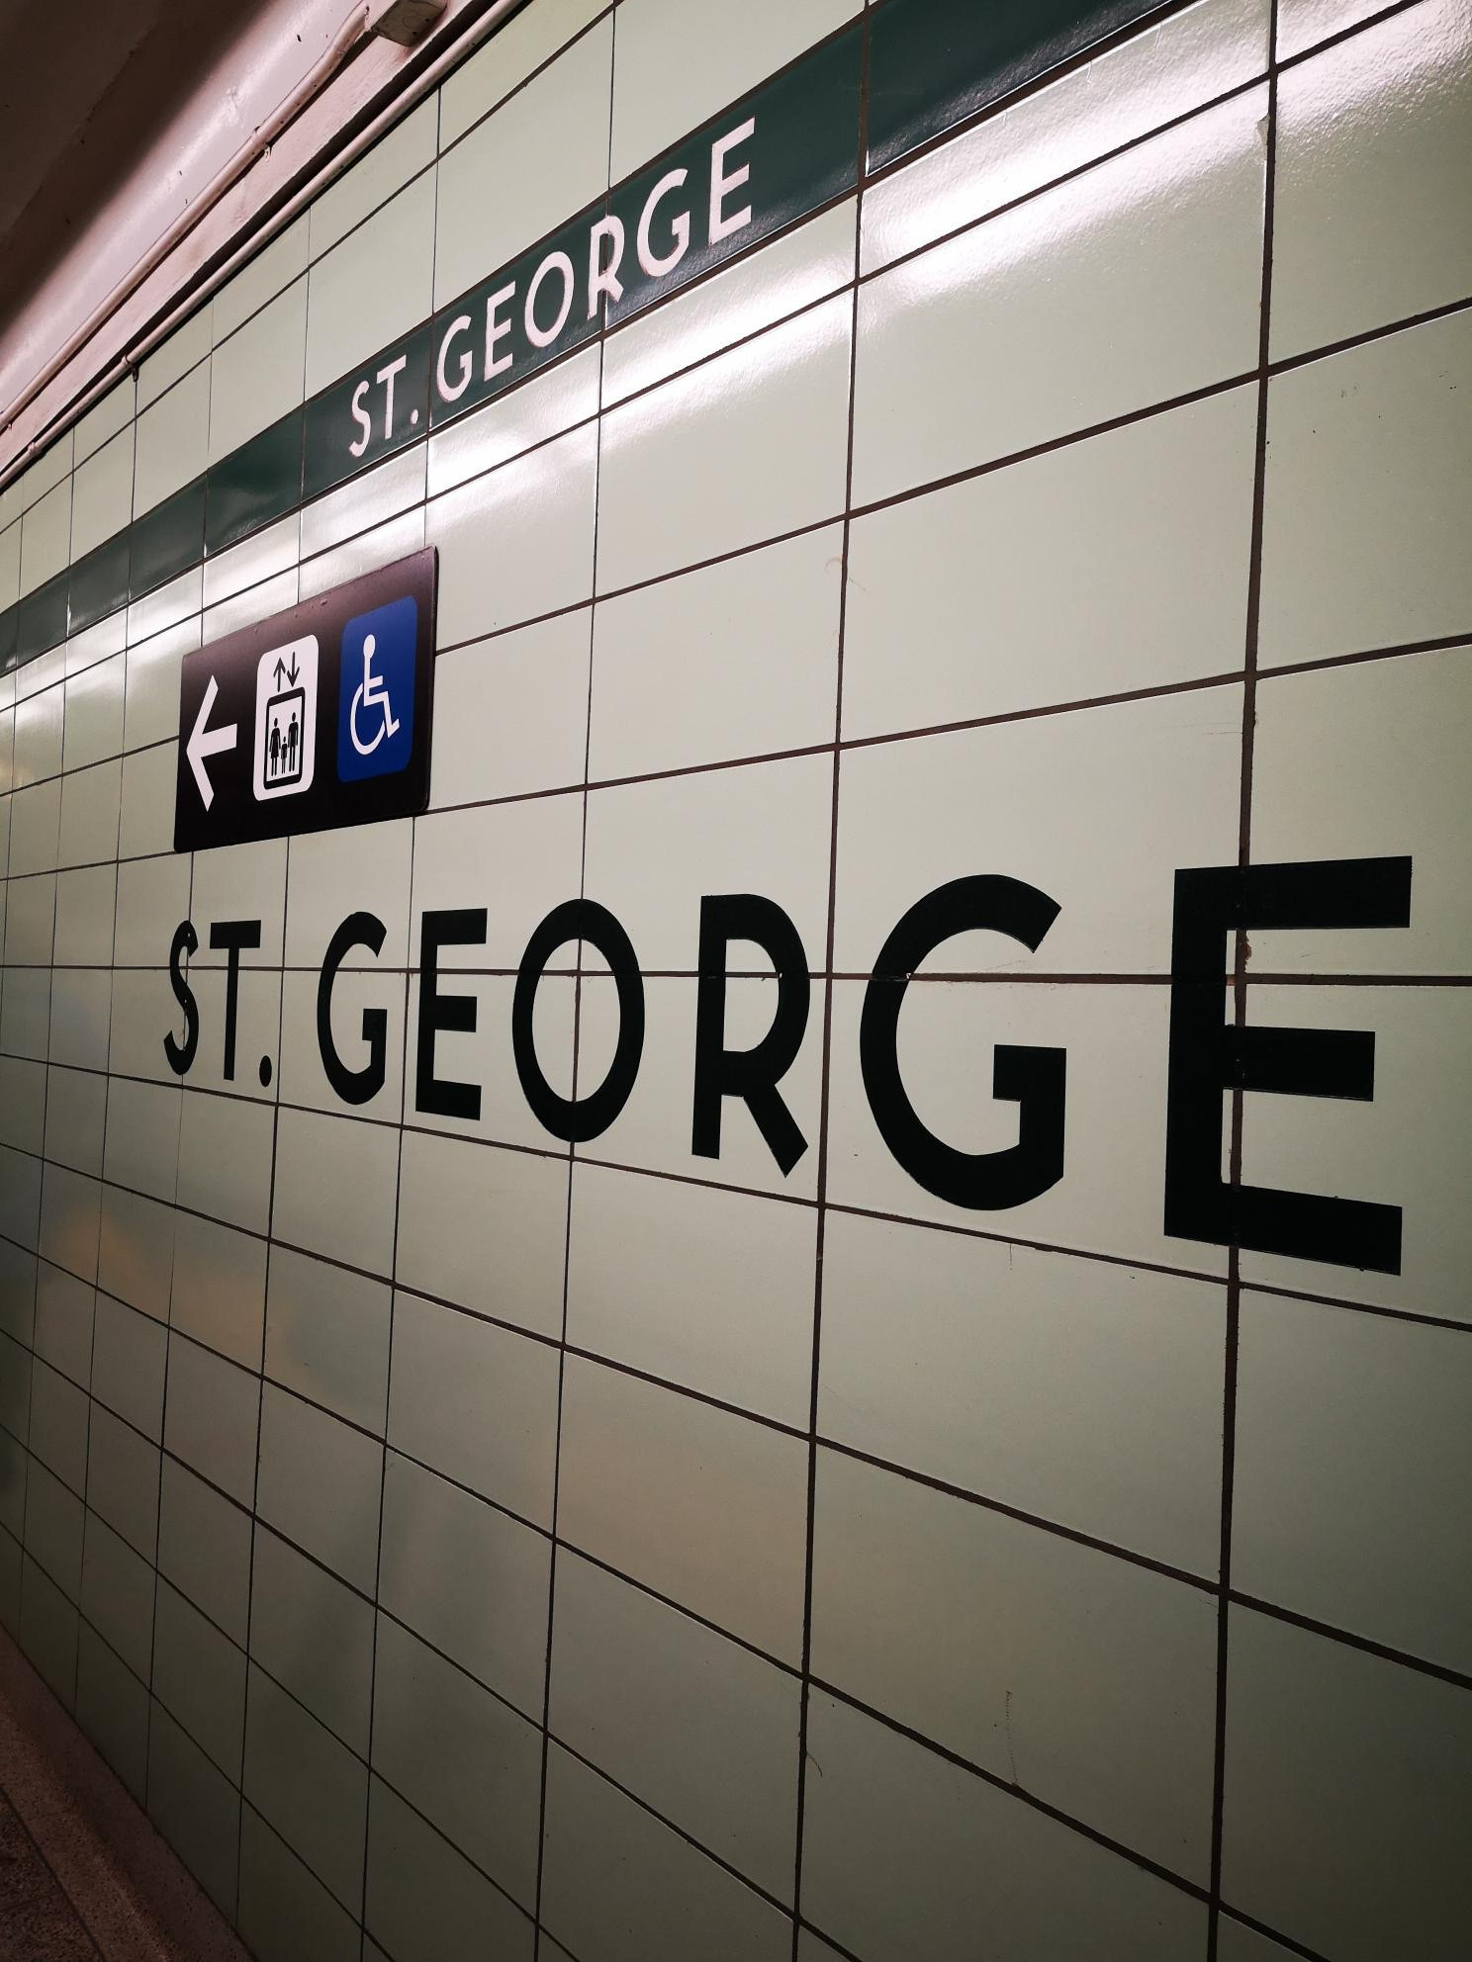
Our journey home

Slide 11
Thanks for stopping by!
Education, Awareness & Culture, ITS, Office of the CIO

Slide 12
Header

Slide 13
Subheader

